Slide 1
The Life Of Christ
Lesson 10
Review Questions
February 5, 2020

Slide 2
Review Questions
Jairus’ Daughter and the Invalid Woman
(Matthew 9:18-26; Mark 5:22-43; Luke 8:41-56)
What were the people at the house of Jairus doing when Jesus arrived? How did Jesus respond?
When Jesus raised the daughter of Jairus from the dead, why do you think He only allowed three of His disciples and the parents of the girls in the room where He performed the miracle? If it were to be a sign, why not allow the whole multitude to see the power of God?

Slide 3
Review Questions
Healing Blind Men and a Dumb Demoniac
(Matthew 9:27-34)
What request did two blind men make of Jesus? What was His response? What did they do after Jesus had healed them?
What was the response of the multitudes when Jesus healed a man who was both mute and demon-possessed? What was the response of the Pharisees?

Slide 4
Review Questions
Jesus Visits Nazareth and Is Rejected
(Matthew 13:54-58; Mark 6:1-6; Luke 4:16-31)
What prophecy did Jesus read in the synagogue? To whom did He apply this prophecy? Why?
Even though Jesus manifested great wisdom in His teachings, what questions did His own countrymen ask of Him? Why?
Why is it said that Jesus “could do no mighty work” in His own country (Mark 6:5; cf. Matthew 13:58)
What did the people of Nazareth want to do to Jesus? What kept them from doing it?

Slide 5
Review Questions
Third Circuit of Galilee. The Twelve Instructed and Sent Forth
(Matthew 9:35-10:1; Mark 6:6-13; Luke 9:1-6)
When Jesus saw the multitude scattered abroad, as sheep without a shepherd, what did He say to His disciples? What did He mean by that?
Where did Jesus send His disciples? What was their purpose in going? Briefly summarize this mission of the twelve?

Slide 6
Review Questions
Herod Antipas Supposes Jesus to be John
(Matthew 14:1-12; Mark 6:14-29; Luke 9:7-9)
How had John the Baptist died?
Why did Herod think Jesus was John?
Return of the Twelve and Retirement to the East Shore of Galilee
(Matthew 14:13; Mark 6:30-32; Luke 9:10; John 6:1)
Upon their return from the mission Jesus had sent them on, what did His disciples report to Jesus? Where did He now instruct them to go? Why?

Slide 7
Review Questions
Feeding the Five Thousand
(Matthew 14:13-21; Mark 6:33-44; Luke 9:11-17; John 6:2-14)
Briefly describe the feeding of the five thousand and what led up to it?
How many baskets of left-overs did the disciples gather? Why do you think there was such a great surplus?

Slide 8
Review Questions
Jesus Walks On The Water
(Matthew 14:22-36; Mark 6:45-56; John 6:15-21)
Where did Jesus go after feeding the five thousand? Why? Where did His disciples go?
What difficulty did the disciples experience while rowing their boat on the Sea of Galilee? What caused them to become afraid? How were their fears quieted?
What did Peter do upon seeing Jesus walking on the sea? What happened to him? How did Jesus respond to him? What was the response of the others in the boat when they saw Jesus and all that He had done?
How did the people of the land of the Gennesaret respond to Jesus?

Slide 9
The Life of Jesus Christ
Lesson 11 – In Galilee And Beyond
February 5, 2020
Discourse on Spiritual Food and True Discipleship –
John 6:22-71

Slide 10
Outline Of
John 6
Verses 1-13 – Jesus’ miracle in feeding the 5000.
Verses 14-25 – Jesus crosses to the other side of the Sea of Galilee and the crowds pursue Him.
Verses 26-34 – Why the multitude sought Jesus.
Verses 35-58 – Jesus is the true bread of life.
Verses 59-66 – The multitudes complain.
Verses 66-71 – Peter’s confession.

Slide 11
“You Seek Me …”
John 6:22-34
“The next day …” – after:
The feeding of the five thousand.
Making His disciples get into the boat to go to the other side.
He sent the crowd away.
He left to go up on the mountain to pray.
He walked on the water to the apostles in the storm.
They came to the other side near Gennesaret …

Slide 12
“You Seek Me …”
John 6:22-34
“The next day …”:
The “crowd that stood on the other side of the sea saw that there was no other boat there, except one, and that Jesus had not entered with His disciples into the boat, but that His disciples had gone away alone.” (verse 22)
They observed one boat and that the disciples got into it without Jesus. Further, they had not returned nor was Jesus there either.
Having desired to make Jesus their earthly king, they got into boats, and proceeded from Tiberias to Capernaum to look for Him.
“When they found Him …’Rabbi, when did You get here?’”
(verse 25) (How? Not answered by Jesus)
They found Jesus in the synagogue in Capernaum
(verse 59)

Slide 13
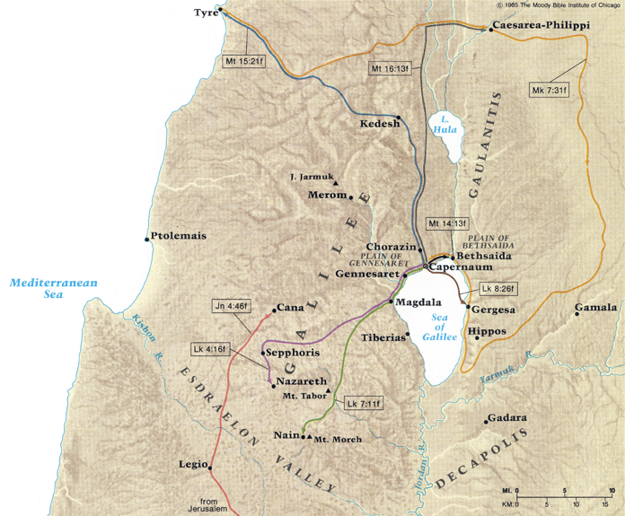

Slide 14
“You Seek Me …”
John 6:22-34
Jesus’ response to those who sought Him:
He knew why they sought Him:
  “Not because you saw signs …” (But they did? cf. verse 14)
  “… because you ate of the loaves and were filled” and now, the day after, you want more. (verse 26)
  They sought Him “for the food which perishes.”
  (verse 27).
  They wanted to know if there was another free meal … today.
  What indicates their desire that Jesus do this for them every day? (verse 31)
Notes:
What type of filter do we examine the evidence with? When they saw the signs, they saw them through fleshly filters.

